Slide 1

24CSA212 –
Full Stack Frameworks
Introduction to Node.js and npm

Slide 2
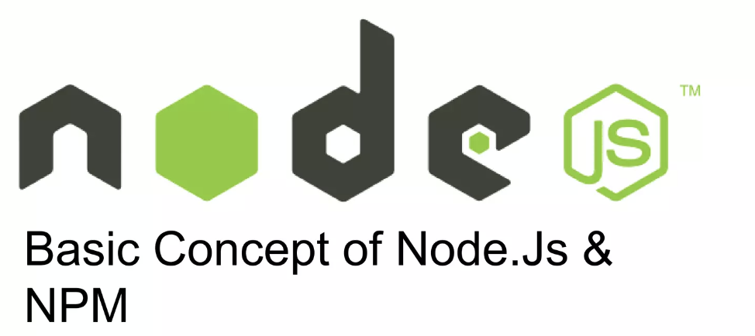

Slide 3
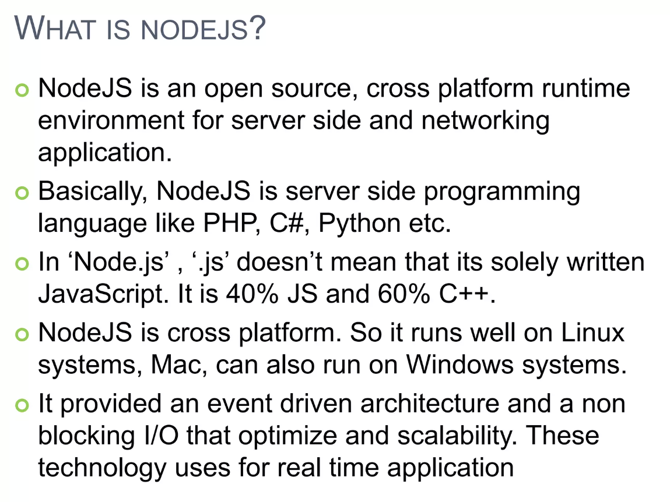

Slide 4
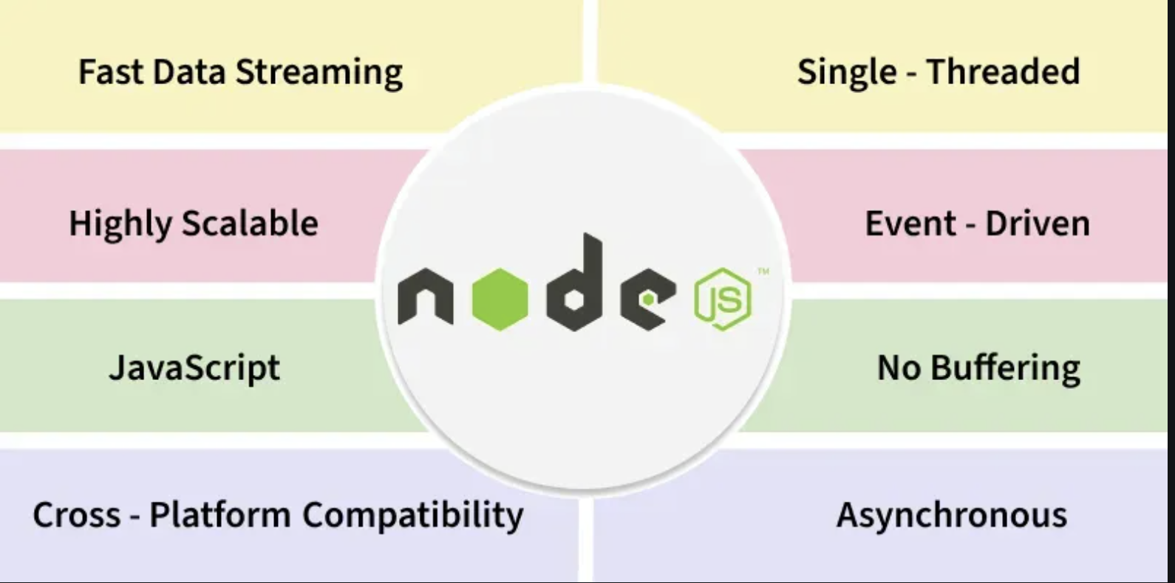
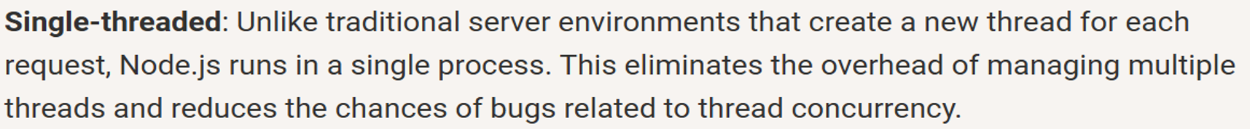
Key Features of Node JS
Fast Data Streaming
Node.js uses streams to process data in small chunks instead of loading everything into memory, making it very fast for handling large files and real-time data.
Single-Threaded
Node.js runs on a single main thread, but it can handle many requests efficiently using non-blocking operations instead of creating multiple threads.
Highly Scalable
Because of its event-driven and non-blocking nature, Node.js can handle thousands of simultaneous client requests with low resource usage.
Event-Driven
Node.js works by responding to events (like requests, file reads, or database calls) using callbacks, promises, or async/await.

Slide 5
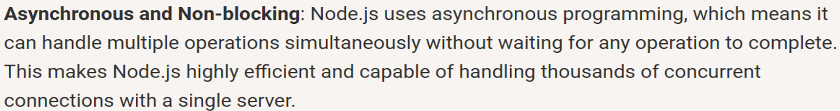
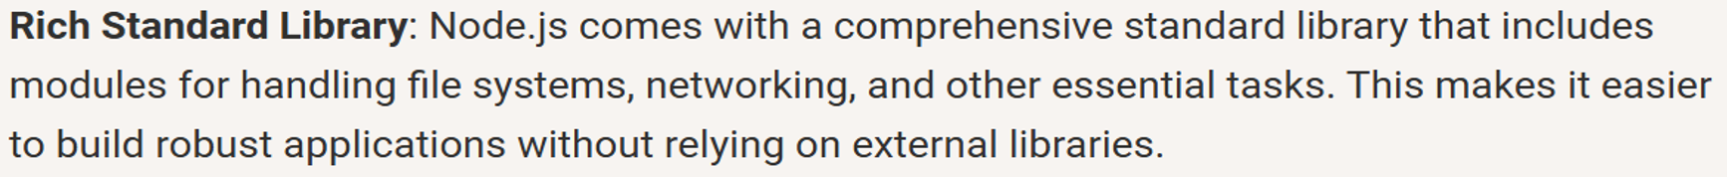
Key Features of Node JS
JavaScript
Node.js allows JavaScript to be used on the server side, enabling developers to use the same language for both frontend and backend development.
No Buffering
Node.js processes data as it arrives instead of waiting for the complete data to load, which improves performance and reduces memory usage.
Cross-Platform Compatibility
Node.js applications can run on multiple operating systems like Windows, Linux, and macOS without code changes.
Asynchronous
Node.js performs time-consuming tasks (like I/O operations) asynchronously, allowing other operations to continue without waiting.

Slide 6
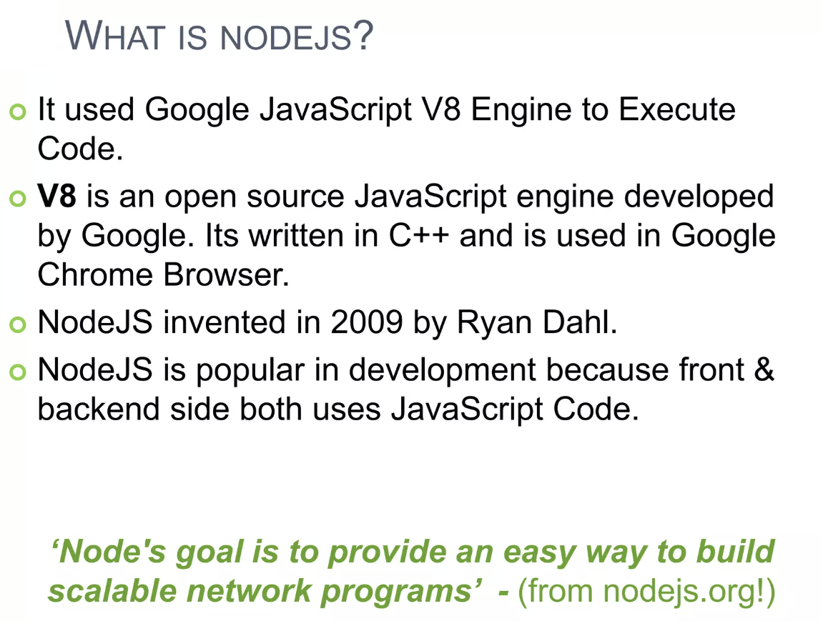

Slide 7
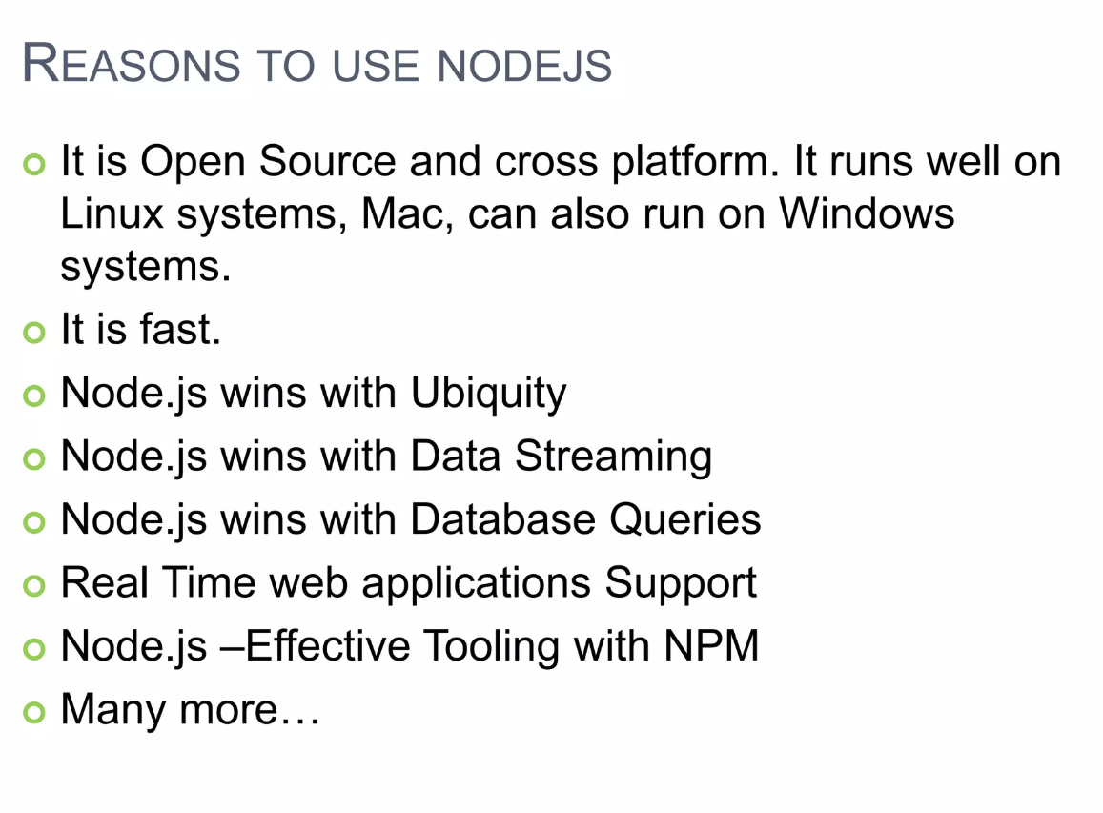
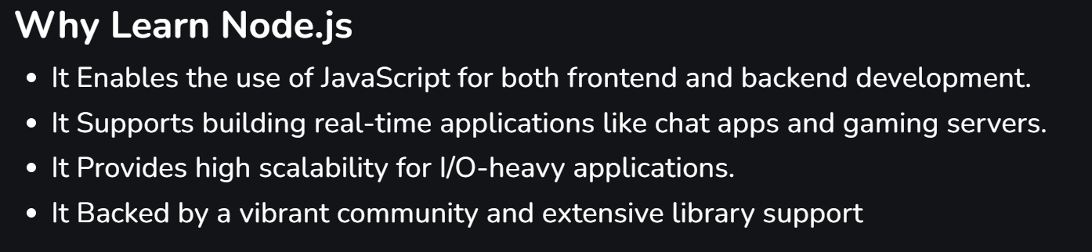
the fact that something or someone seems to be everywhere:

Slide 8
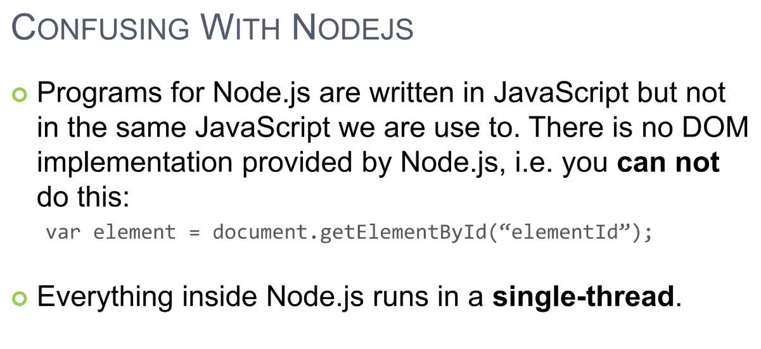

Slide 9
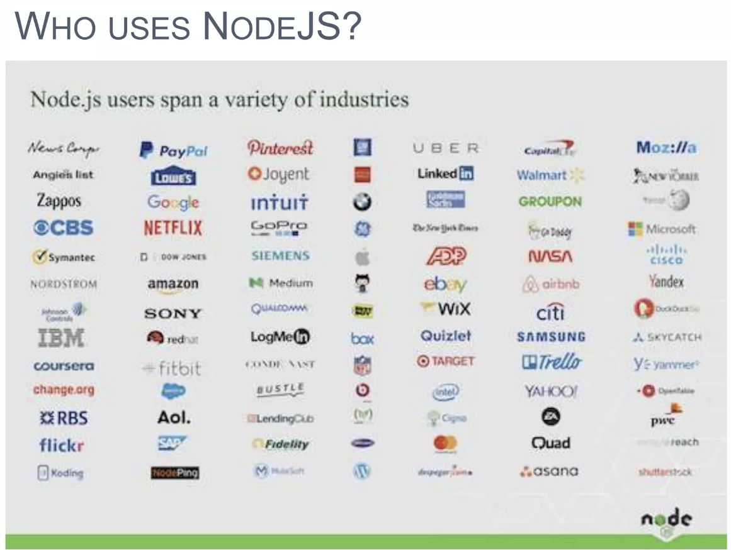

Slide 10
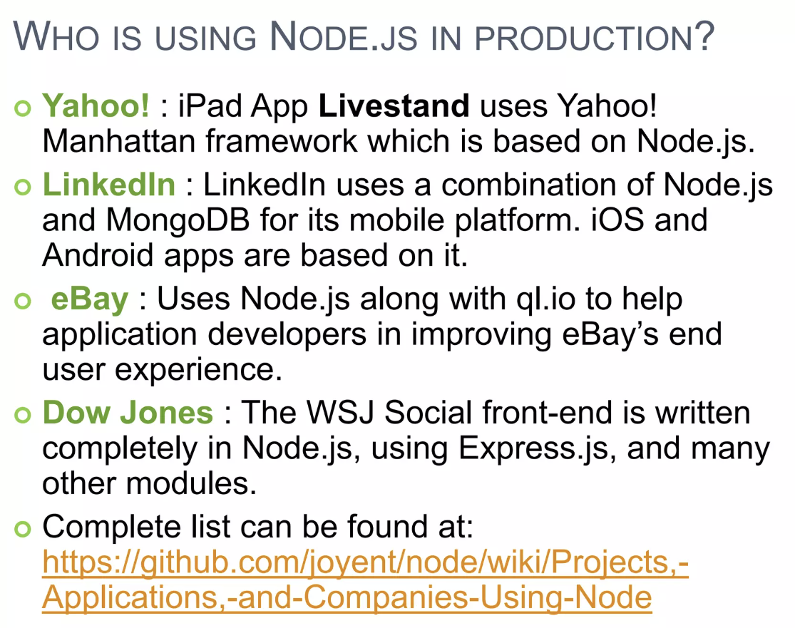

Slide 11
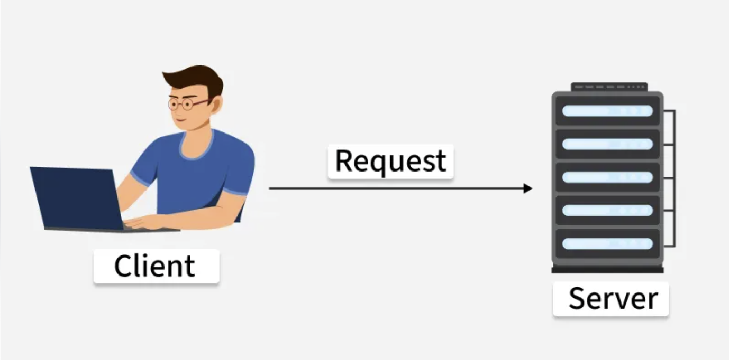
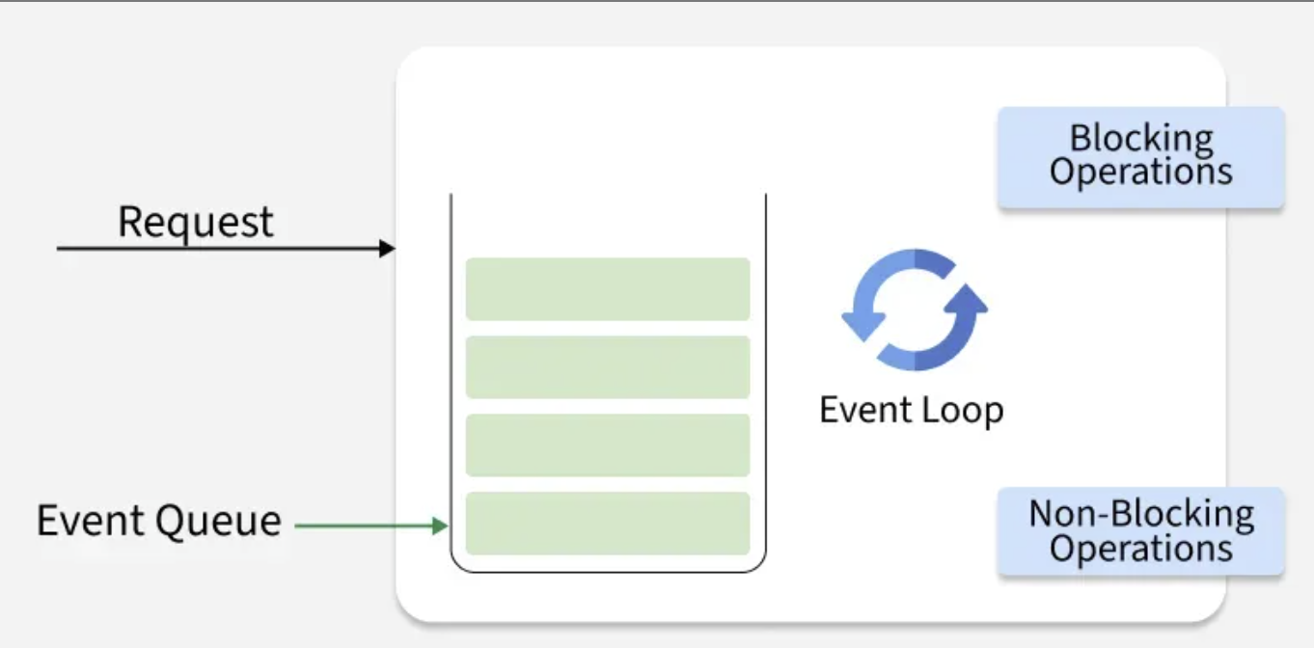
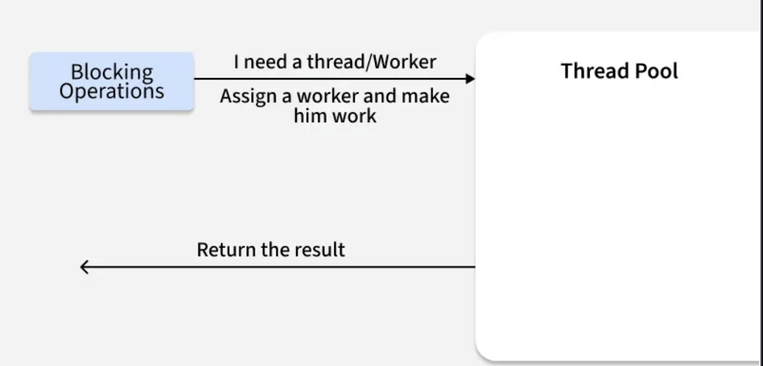
Working of Node.JS
Node.js is a runtime environment that enables JavaScript to run outside the browser for building scalable server-side applications.
Built on the V8 JavaScript engine.
Uses asynchronous, event-driven architecture.
Suitable for scalable network applications.

Slide 12
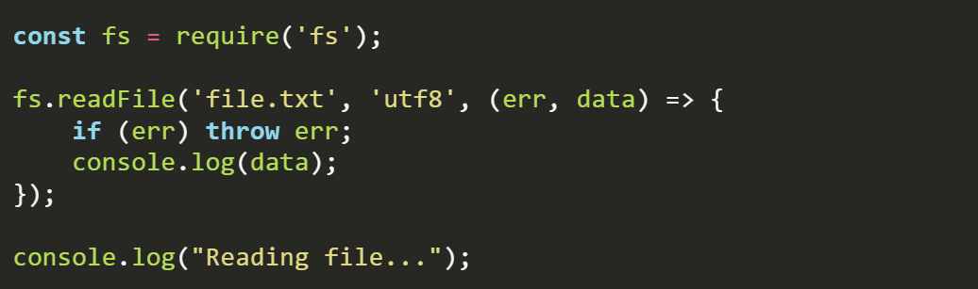
Single-Threaded Event Loop Model
Node.js operates on a single thread but efficiently handles multiple concurrent requests using an event loop.
Client Sends Request: Requests data, files, or database operations.
Event Loop Handles It: Non-blocking tasks are offloaded without stopping execution.
Background Processing: Node.js continues handling other requests.
Callback Executes: Response is returned once the task completes.

Slide 13
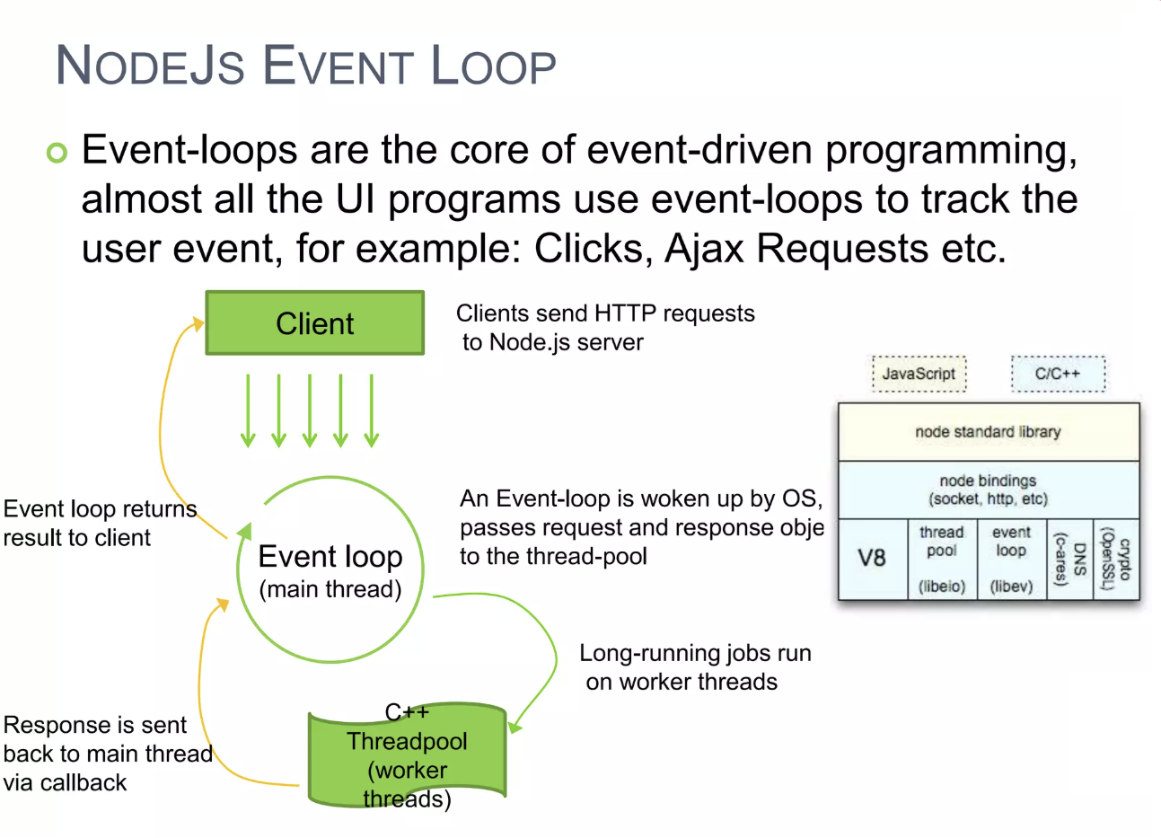

Slide 14
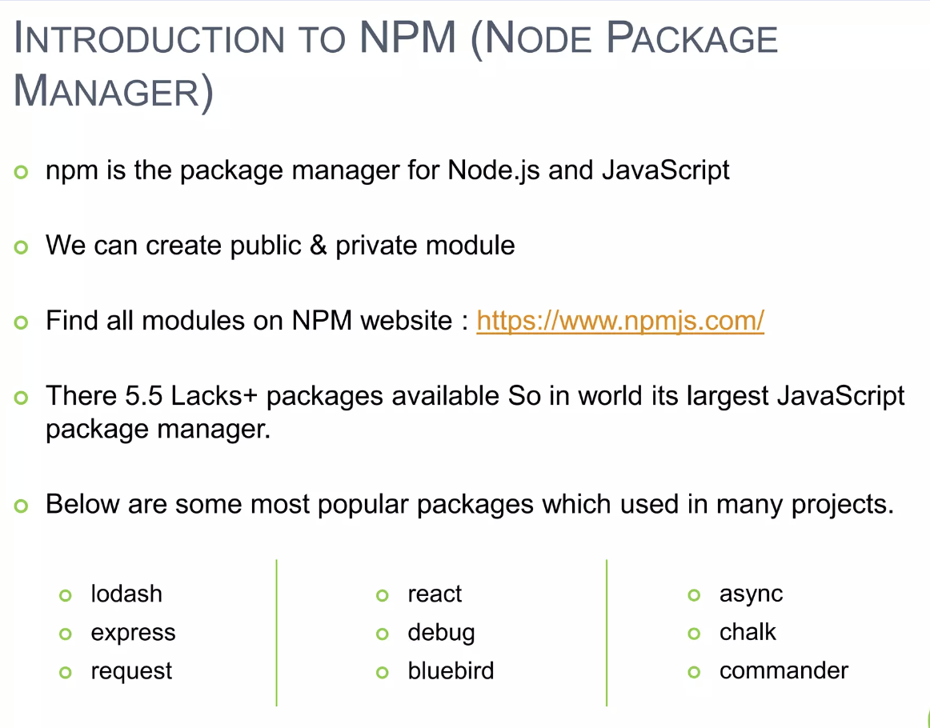

Slide 15
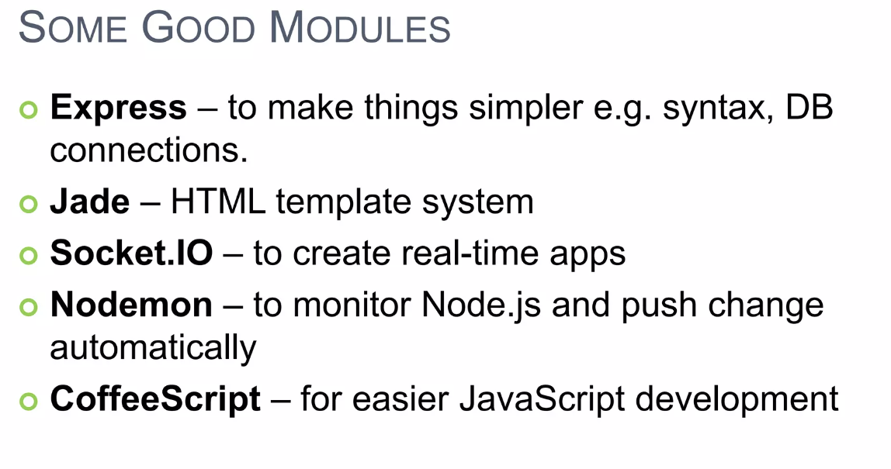

Slide 16
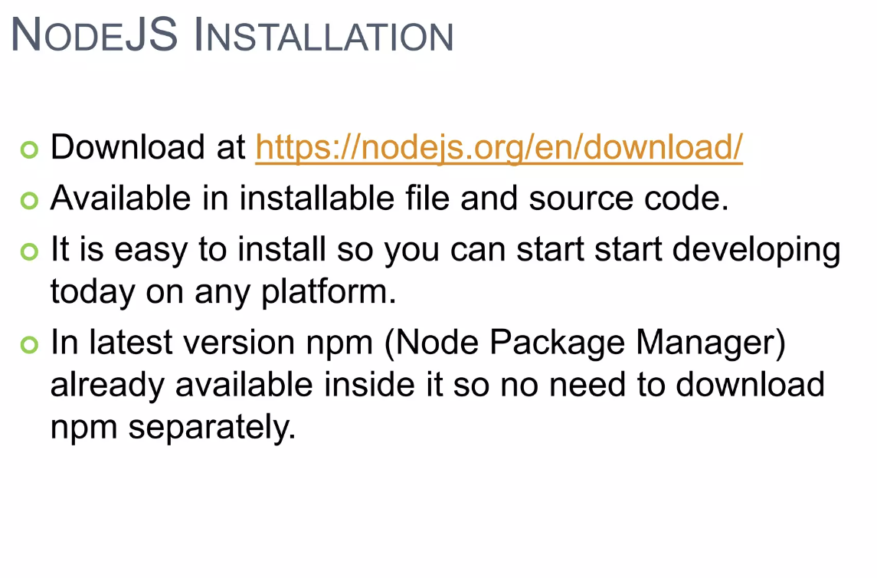

Slide 17
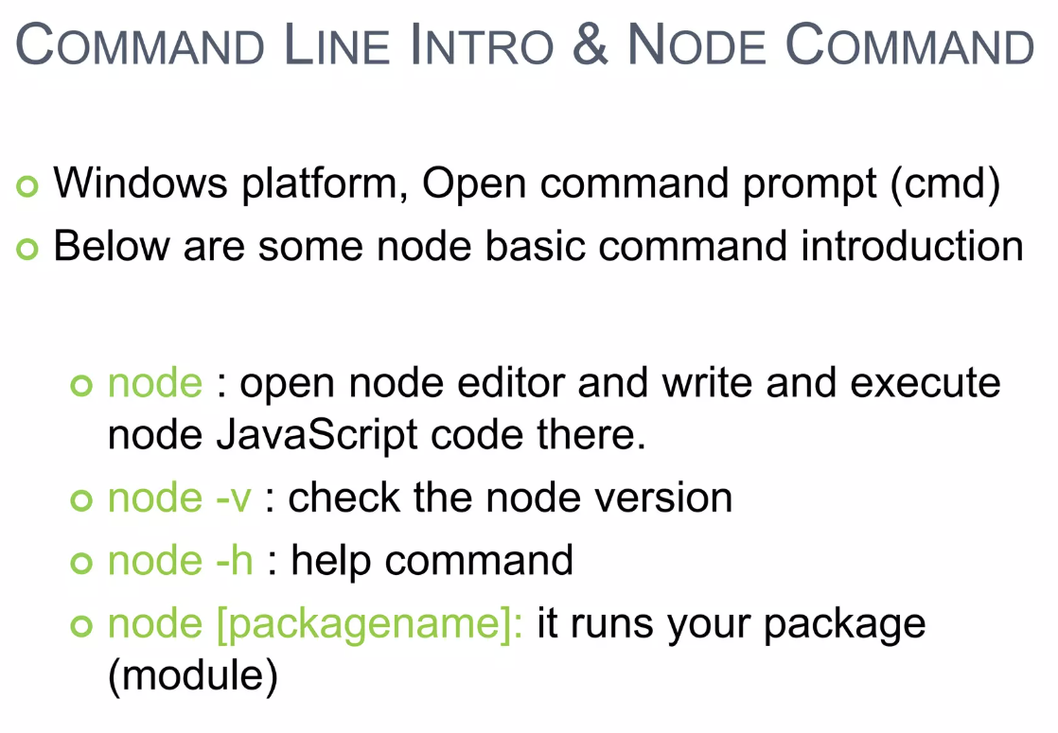

Slide 18
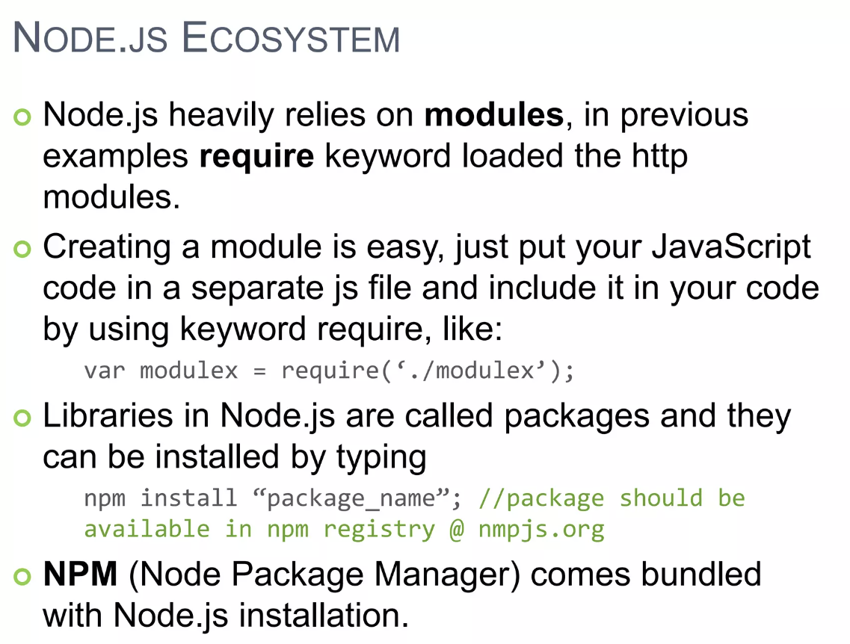

Slide 19
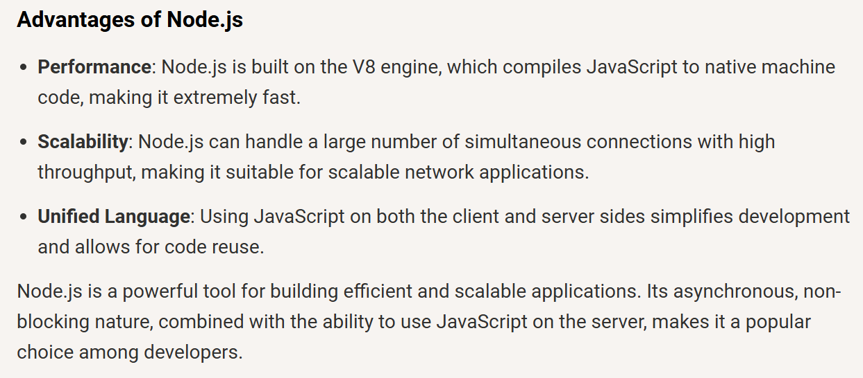

Slide 20
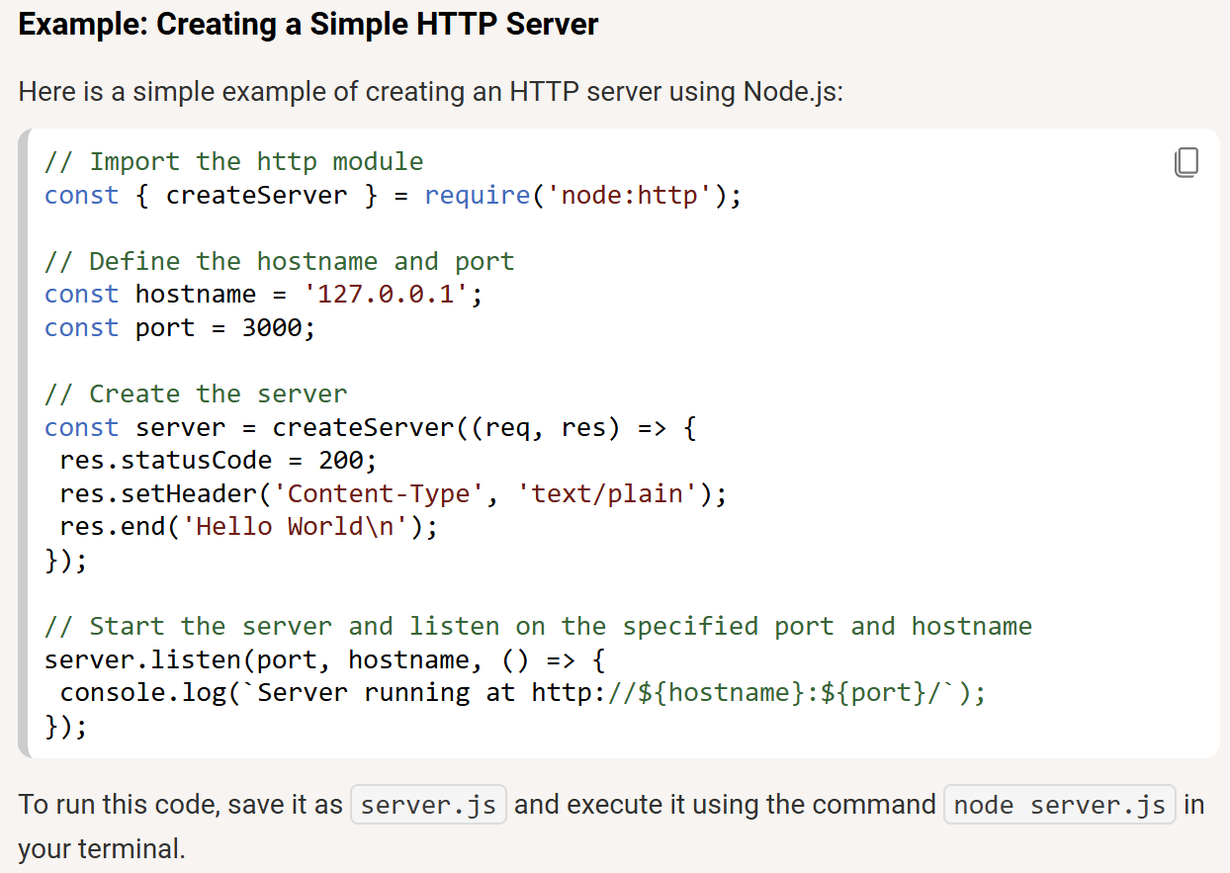
It will start a server, and when you visit http://localhost:3000, it will display
Hello World
The http module is imported to create a basic HTTP server.
The createServer() method is used to handle incoming requests and send responses.
The server listens on port 3000, and a message is displayed in the browser when accessed.

Slide 21
Components of Node.js Architecture
Node.js architecture consists of components that work together to handle asynchronous, non-blocking operations efficiently.
V8 Engine: Compiles JavaScript to machine code for fast execution.
Event Loop: Manages asynchronous tasks without blocking the main thread.
Libuv: Handles I/O operations, thread pool, and timers.
Non-Blocking I/O: Executes tasks without waiting for previous ones to complete.

Slide 22
Use Cases of Node.js
Node.js is well suited for building high-performance, scalable, and real-time applications. Common use cases include:
Web APIs and Backend Services: Used to build RESTful APIs and GraphQL APIs and power backend services for web and mobile applications.
Real-Time Applications: Chat applications (e.g., WhatsApp, Slack). Live streaming services (e.g., Netflix, Twitch).
Microservices Architecture: Enables building scalable, independent services, commonly used in cloud-based applications.
IoT (Internet of Things) Applications: Handles real-time data streams from devices, making it suitable for smart homes and sensor-based systems.
Serverless Computing: Efficiently runs lightweight functions on cloud platforms like AWS Lambda and Azure Functions.
Single-Page Applications (SPAs): Supports React, Angular, and Vue.js apps by efficiently handling backend API requests.
Data-Intensive Applications: Handles real-time analytics and integrates well with NoSQL databases like MongoDB and Firebase.

